Slide 2
Chapter 1: Introduction
Part A: Core Concepts
Part B: The Practicalities
Rationale, Scope and Background of Cultural Risk Assessment and CIERA
Chapter 2:
Chapter 8:
Cultural Risk Assessment & The Cultural Inclusivity and Equity Risk Assessment (CIERA)
Chapter 3: Cultural Risk – EEDI and Bias
Activating Theory -
England and Wales Cricket Board
Chapter 9:
Chapter 4: The Science of Inclusion and Bias
Managing Organisational Risk: Integrating Cultural Risk Awareness into Corporate Governance
Chapter 10:
Chapter 5: Culture
Chapter 11:
Comparing faith in cultural contexts: In Sacred Spaces and on the Dancefloor
Chapter 6: Theories and Frameworks
Chapter 12:
Activating Theory - Action Research with Faith Leaders for the British Ritual Innovation in COVID
Chapter 7: Cultural Intelligence (CQ)
Chapter 13:
Between the lines -
Conversations in Context, a Dialogical Approach
Part C: Case Studies
CS 1: Sweden – Religious Heritage
CS 10: UK – Faith and Sexuality
CS 2: UK – Sensory Rooms
CS 6: Qatar – Football World Cup
CS 11: UK – Cultural Events
CS 3: England – Prom Events
CS 7: USA – NFL
CS 12: USA – Belonging and Ethnicity
CS 4: UAE – Cultural Awareness
CS 8: Japan – Cultural Heritage
CS 13: Caribbean – Diaspora Communities
CS 5: Australia – Indigenous Communities
CS 9: UK – Sport and Gender
CS 14: Nigeria – Business Events

Slide 3
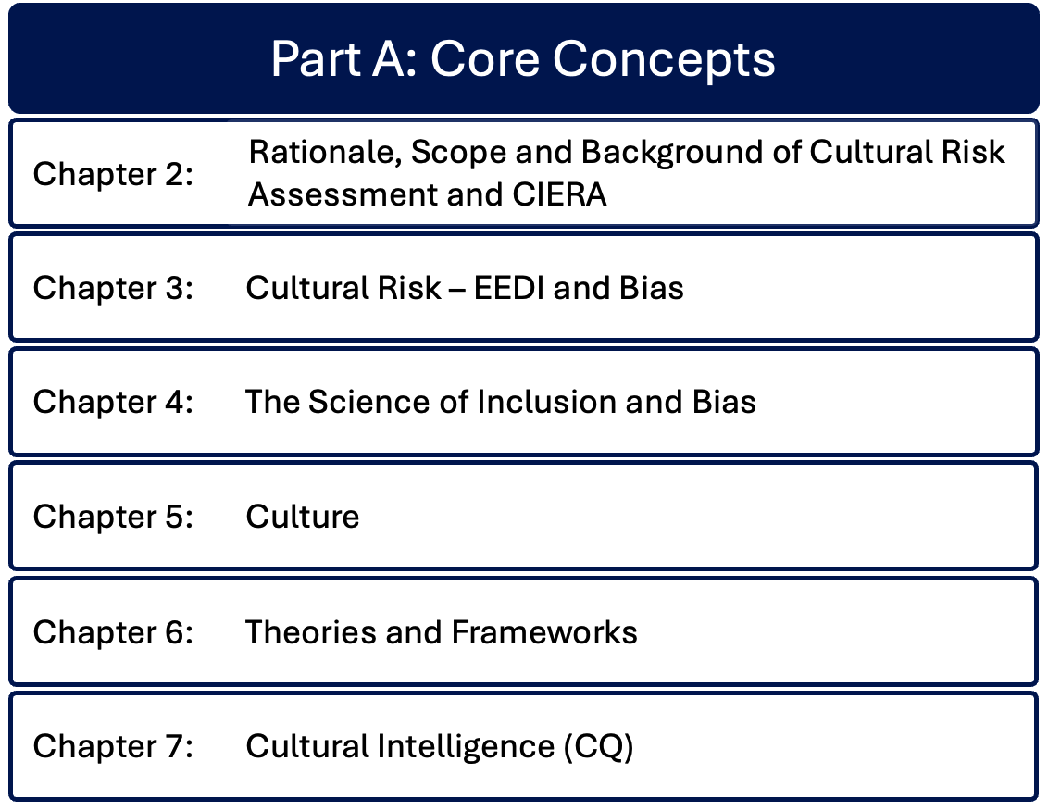

Slide 4
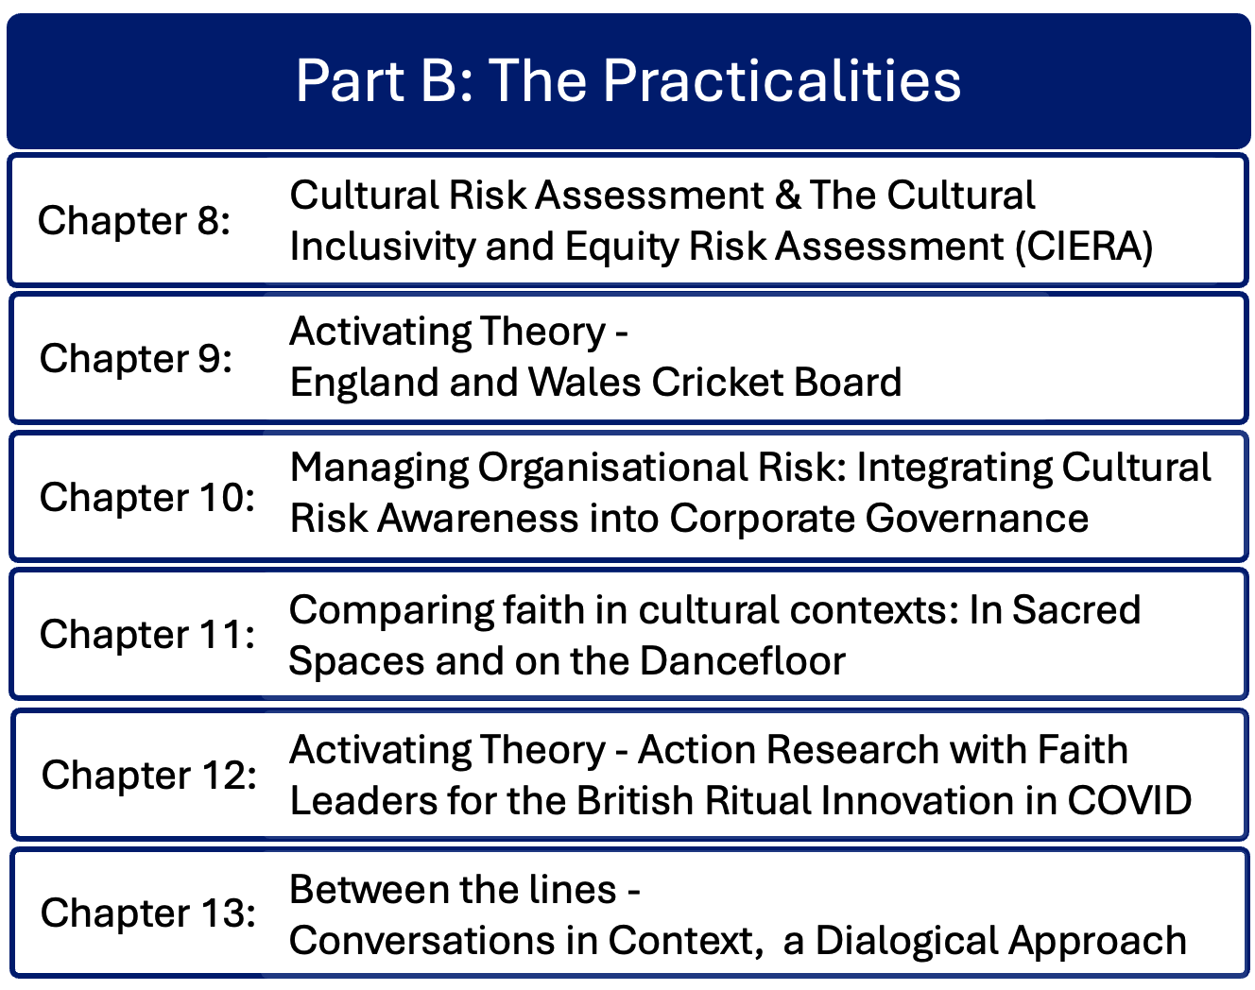

Slide 5
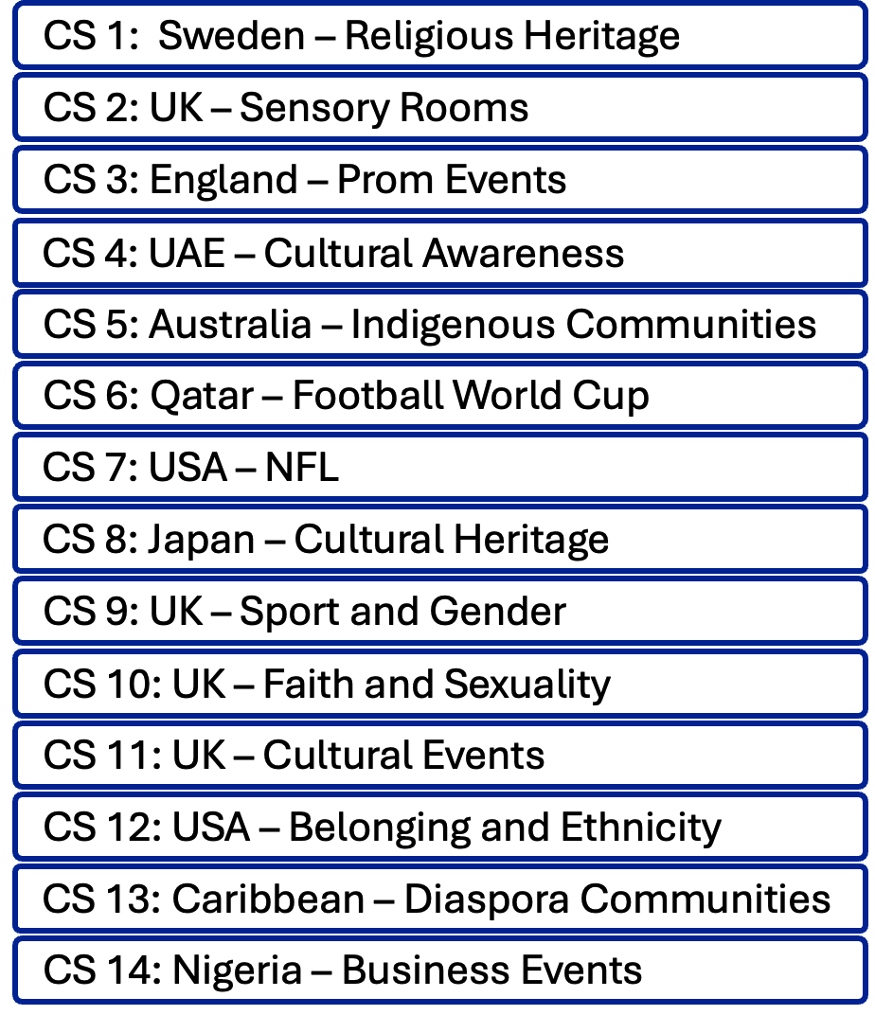
Part C: Case Studies
Real life international case studies of cultural issues in events contexts, contributed by international academics and practitioners.
Provides background and context of the organization in which the cultural issues occurred, with detailed scenarios of cultural issues in the event
Explains how and why the cultural issues came about, suggesting potential mitigation of each cultural issue, with specific actions
Identifies benefits of undertaking a cultural risk assessment prior to and/or during the scenario
More than one cultural risk (intersectionality) in each scenario. Cultural risks include religious, ethnic, heritage, social, ethical, language, dietary restrictions and requirements, dress codes, sal interaction, gender, sexuality, neurodiversity, local factors, and other aspects

Slide 6
Case Study 1: Sweden – International Religious Heritage Conference Ruth Dowson
Future for religious Heritage – a secular organisation protecting religious heritage
Europe has thousands of current and former places of worship
Cultural issues
Religious heritage conference dates clashed with Muslim religious festival of Eid al Fitr and the end of the fasting month of Ramadan. A Keynote speaker was a Muslim but no other Muslims attended the conference. Conference organisers should have checked a religious calendar prior to fixing the date
Dietary requirements were well catered for – all meals were vegetarian and alcohol-free dishes
Engagement with the local community through activities for local youth and Sami ethnic singer in concert

Slide 7
Case Study 2: UK – Sensory Rooms Ruth Dowson
Focus on installation of sensory rooms at unusual event venues
Aimed at providing multi sensory environments for neurodiverse children and young people
An AIM-accredited church venue that hosts commercial events. Sensory room funded by charities, ‘Kids Out’ and Women’s Aid. Also used by local community.
County cricket stadia, some have on site specialist rooms, others have hired temporary facilities

Slide 8
Case Study 3: UK – Sixth Form Prom events Joanna Taylor
Post A-Level exams prom for 200 students, organised by a team of staff and students in an event venue with accessible parking, lifts and disabled toilets
Cultural issues – health, ethnicity, gender identity, access to toilets, dress codes and menu.
Dietary requirements collected in advance with menu adjustments made for vegan, vegetarian and religious dietary requirements
Venue toilet facilities included labelling for male, female and disabled use, but none labelled for non-binary people i.e. ungendered toilets needed.
Attendees questioned negative connotations of ‘dis-abled’
Some interpretations of ‘formalwear’ did not meet expected dress code.

Slide 9
Case Study 4: UAE – Developing cultural awareness for events in the United Arab Emirates Anonymous
Factors to consider when hosting and event in the Middle East: culture, religious beliefs, safety
Saudi Arabia – hosting sporting events e.g. 2034 FIFA Football World Cup
Qatar – hosted FIFA Football World Cup 2022 cultural issues, religion, dress, alcohol, sexuality, climate
United Arab Emirates – 7 states including Dubai, Abu Dhabi – sports events, F1, Golf, Rugby, Music concerts. 2024 Caribbean Carnival events. Issues – climate
Muslim culture – modest dress, respect for culture in event content and participant behaviour. Alcohol is a sensitive issue. Gender separation on public transport.
Restrictions on events in the month of Ramadan, need to be held either after daily Iftar (breaking fast), or move to another month.

Slide 10
Case Study 5: Australia – Getting together in Melbourne Maureen Griffiths
Moomba – indigenous event
Cultural issues: ethnicity of the choice of Moomba Monarchs; naming of the festival
Festival name chosen before thorough research undertaken into the multiple meanings of the word and without public consultation. The name has multiple indigenous meanings, one of which is sensitive.
Initial selections of Moomba Monarchs were from outside Australia
Use of fireworks in contrast to the festival’s environmental credentials

Slide 11
Case Study 6: Qatar – 2022 Football World Cup Ahmed El Turabi
FIFA Men’s World Cup: selection of Qatar for 2022 was controversial.
Qatar had no previous experience of hosting a major sports tournament. Extreme climate (heat) in Summer resulted in moving the tournament to a cooler months, clashing with national leagues in other countries.
As a Muslim country, Qatar’s strict codes of behaviour and culture contrasted with European influenced football culture, especially alcohol, and Western attitudes to homosexuality, impacting potential sponsorship
Preparations for the local population to learn about attitudes of football fans and vice versa. Preparations for the large number of international guests, equivalent to 1/3 of the population of Qatar with significant potential for disruption and unbalance to local social ecosystem impact of strict Muslim codes of behaviour towards alcohol and homosexuality impacted potential sponsors and international pundits.

Slide 12
Case Study 7: USA – The NFL, Colin Kaepernick and athlete activism and protests at sporting events. Alister Albert
USA’s National Football League (NFL) is the world’s most lucrative sporting league, hosting American football events outside USA to extend global reach and expand merchandise sales.2016 player Colin Kaepernick protested against police brutality by kneeling during the US national anthem instead of standing or staying in the entry tunnel.
Long history of athlete activism and protests included Muhammad Ali in 1967 fro resisting conscription.
Cultural risk created when such activism is addressed by sporting clubs and authorities, causing moral and financial dilemmas.

Slide 13
Case Study 8: Japan – Revitalisation of local cultural heritage in Nakanojo Biennales Dr Shin Yasuda
Nakanojo Biennale is a one month contemporary arts festival held every two years in September-October in Gunma Prefecture, Japan
Showcases local and international artists, attracting visitors from the region and beyond. Incorporates local traditional arts and cultural heritage.
Cultural issue – transformation of local culture where greater international mobility is changing perspectives, risking commodification and de-contextualisation.
Falling birth rates, aging population and global mobility are influencing the disappearance of local culture in some parts of Japan

Slide 14
Case Study 9: UK – Gender equity and inclusion in sport – The 2023 Richmond Gender in Sport Research Centre Conference Dr Lucia Morawska
Analysis of cultural, logistical and strategic challenges of a conference focused on gender equity and inclusion in sport
Accessibility and inclusion – venue selected for accessibility; cultural aspects of dietary preferences and restrictions. Offered vegetarian, vegan, halal, gluten-free and other requirements. Identified requirements during detailed registration process to prepare diverse meal options
Diversity of sports and panellists – from a range of gender identities, ethnic backgrounds, professional sectors, disability, who were able to contribute to the conference themes
Sessions acknowledged complexities of intersectionality and representation
Logistical challenges and mitigations – clear venue signage and advance registration process

Slide 15
Case Study 10: UK – LGBTQ+ inclusion for an evangelical charismatic church organisational risk Ashley Hardingham
Large evangelical church took policy decision to welcome LGBTQ+ people into church leadership
Church initially addressed accessibility issues for disabled people, then welcoming people of more diverse ethnicities
Inclusion of LGBTQ+ people was an organic development but resulted in immediate resignations. The church followed a one-year listening consultation process for the issue, but many of the more conservative members left the church. Learning to disagree and communicate openly.
The church welcomes people of diverse ethnicities, neurodiverse, children and LGBTQ+ people.

Slide 16
Case Study 11: UK – Bradford 2025, UK City of Culture Miriam O’Keefe
City of Bradford West Yorkshire awarded UK City of Culture status for 2025 – opportunity for diverse community to experience cultural regeneration and economic growth
Cultural risks – engagement with diverse communities; cultural appropriation of diverse heritage; artistic integrity compromises; neglecting the city’s cultural heritage
Cultural aims – to address social inequalities, divided communities; need authentic cultural representation and local ownership of programmes and activities; extending outcomes for long term impact; protection from political interference; securing funding; acquiring relevant artists; ensuring safety and security, managing diverse stakeholders and communications
Mitigation – community engagement, cultural sensitivity, artistic integrity, legacy planning, governance and transparency

Slide 17
Case Study 12: USA – From assumption to belonging: a Nashville journey of identity and inclusion Trenay Perry Bynum
Personal story of starting a career in PR as a young Black woman from California in a PR agency in a predominantly Ivy-league wealthy agency environment in Nashville Tennessee
Cultural issues of race, educational and economic background, geography
Case study proposes actions for enabling cultural intelligence in a corporate context

Slide 18
Case Study 13: Caribbean – Cultural risks and diaspora community heritage events Mandy Preville-Findlay
Identity issues in different cultural contexts for Caribbean diaspora communities
Beyond Iyanola organisation enables St Lucian and wider Caribbean heritage residents in the UK to learn more about their diaspora heritage including through events
Cultural issues with a summer event that had female dancers only due to lack of male dance partners

Slide 19
Case Study 14: Nigeria – Cultural risks in event planning in Nigerian corporate events Origomisan Jekhine
Nigeria has over 500 ethnic groups and three major tribal groups: Hausa, Igbo Yoruba. Population 222 million. Southern Nigeria is largely Christian, Northern Nigeria is largely Muslim. Economic capital of Nigeria is Lagos, Abuja is the country’s capital city. Official language: English.
Energy conference 2016, Abuja: Monday-Wednesday. Planned keynote from Nigerian Vice President was delayed, his late arrival had 15 minutes’ notice but went ahead without hitches after changes to schedule.
Energy conference 2014, Abuja: Wednesday-Friday. Muslim conference participants were not given additional time in the programme to attend Friday prayers and would miss lunch. Muslim delegates drew organisers’ attention to this issue and changes were made to the overall programme to facilitate their attendance at prayers and lunch provision afterwards.

